Slide 1
Lecture 2 Lexical Analysis 2-7
Confliction Resolutions

Slide 2
Outline
From Regular Expressions to Implementation
From Regular expressions to NFAs
Inductive method
From NFA to DFA
Subset construction algorithm
Minimizing DFA
State-Minimization Algorithm
Confliction resolutions

Slide 3
Challenges in Scanning
How do we determine which lexemes are associated with each token?
When there are multiple ways we could scan the input, how do we know which one to pick?
Maximal munch
priority system
How do we address these concerns efficiently?

Slide 4
Lexing Ambiguities
T_For
T_Identifier
for
[A-Za-z_][A-Za-z0-9_]*

Slide 5
Lexing Ambiguities
T_For
T_Identifier
for
[A-Za-z_][A-Za-z0-9_]*
f o r t

Slide 6
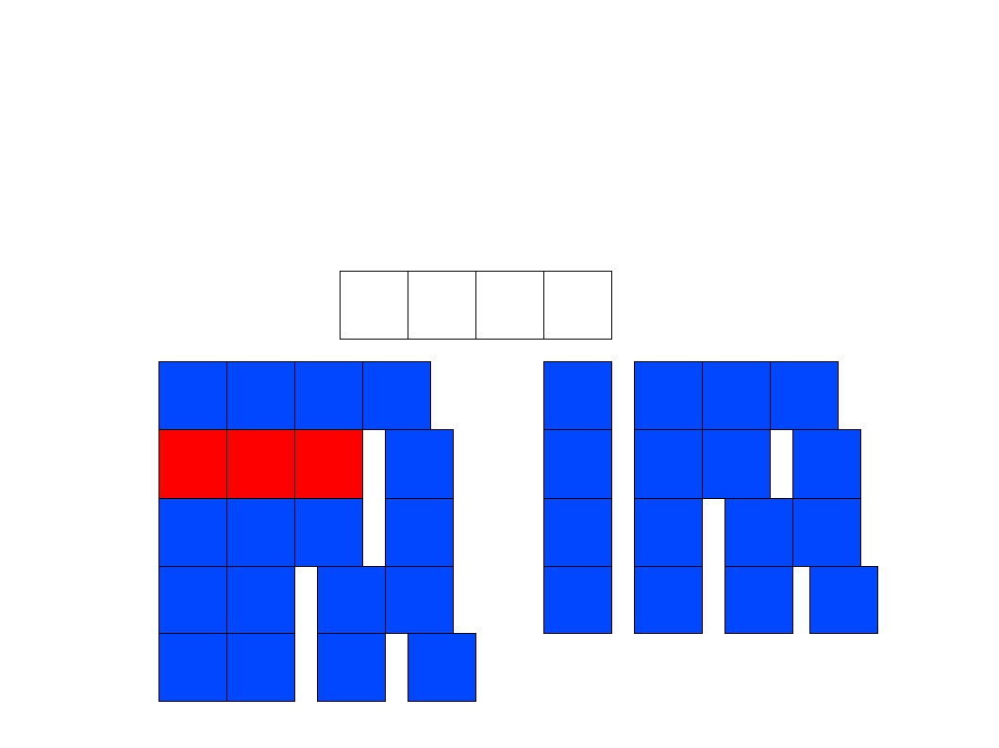
Lexing Ambiguities
T_For
T_Identifier
for
[A-Za-z_][A-Za-z0-9_]*
f o r t
f
o r
t
f
o r t
f
f
o r
o r
t
t
f
f
o r
o
t
r t
f
o
r
t
f
o
r
t
f
o
r
t

Slide 7
Conflict Resolution
Assume all tokens are specified as regular expressions.
Algorithm: Left-to-right scan.
Tiebreaking rule one: Maximal munch.
Always match the longest possible prefix of the remaining text.

Slide 8
Lexing Ambiguities
T_For
T_Identifier
for
[A-Za-z_][A-Za-z0-9_]*
f o r t
f o r t

Slide 9
Implementing Maximal Munch
Given a set of regular expressions, how can we use them to implement maximum munch?
Idea:
Convert expressions to NFAs.
Run all NFAs in parallel, keeping track of the last match.
When all automata get stuck, report the last match and restart the search at that point.

Slide 10
Implementing Maximal Munch
T_Do
T_Double
T_Mystery
do
double
[A-Za-z]

Slide 11
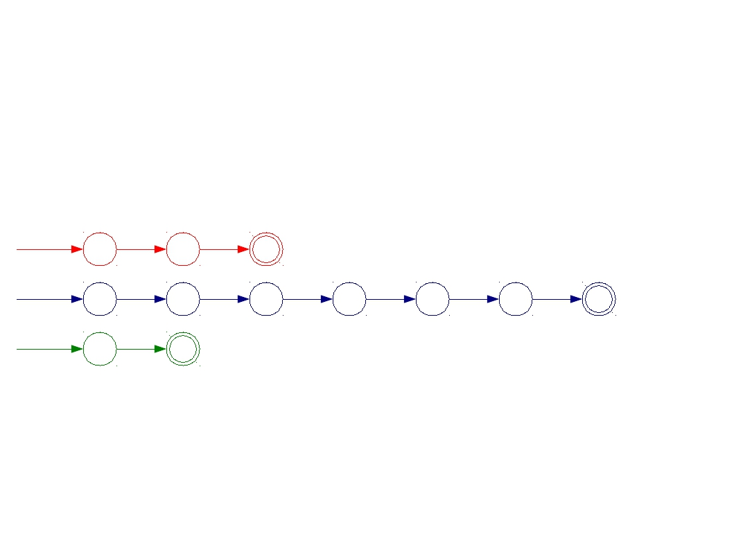
Implementing Maximal Munch
T_Do
T_Double
T_Mystery
do
double
[A-Za-z]
start
d
o
start
d
o
u
b
l
e
start
Σ

Slide 12
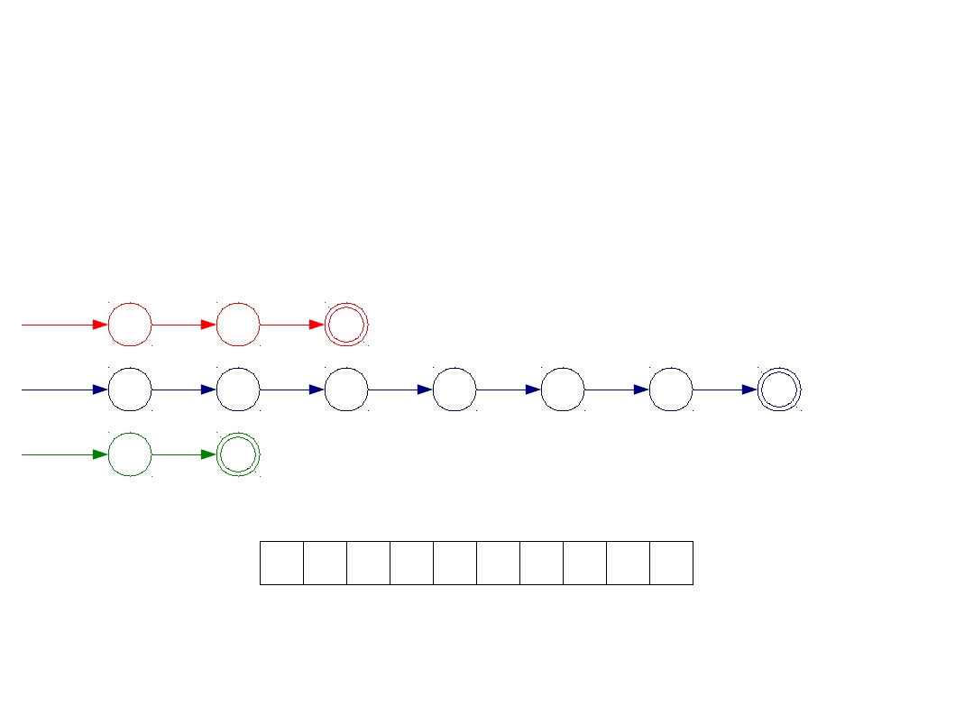
Implementing Maximal Munch
T_Do
T_Double
T_Mystery
do
double
[A-Za-z]
start
d
o
start
d
o
u
b
l
e
start
Σ
D O U B D O U B L E

Slide 13
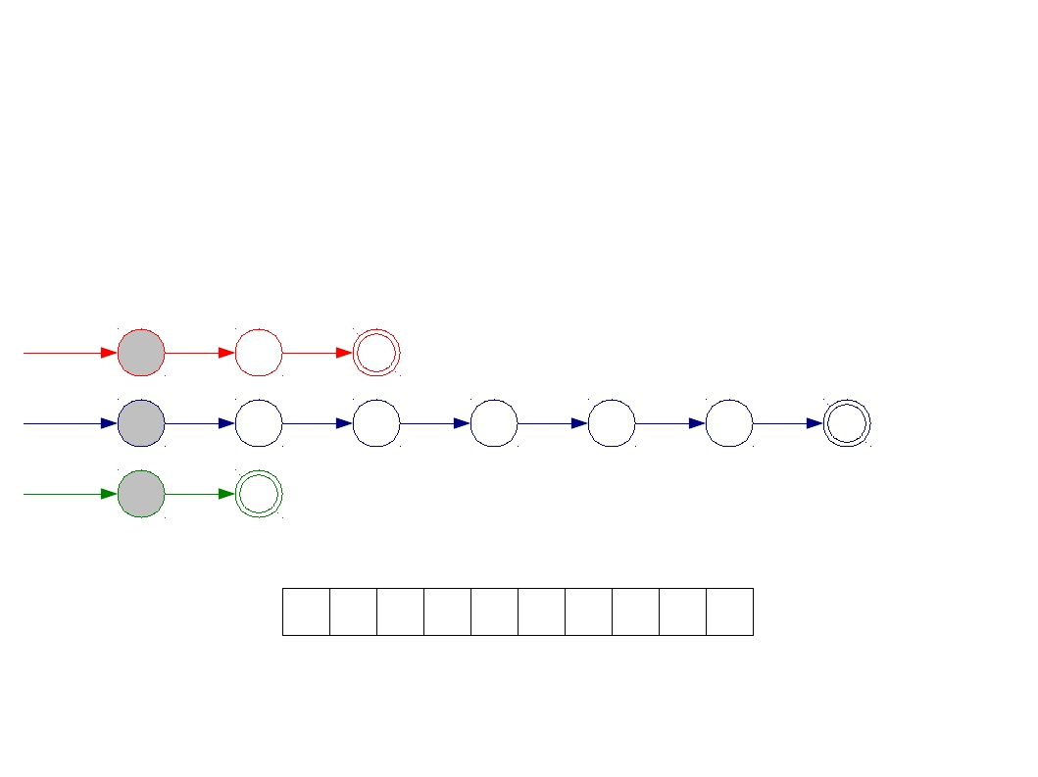
Implementing Maximal Munch
T_Do
T_Double
T_Mystery
do
double
[A-Za-z]
start
d
o
start
d
o
u
b
l
e
start
Σ
D O U B D O U B L E

Slide 14
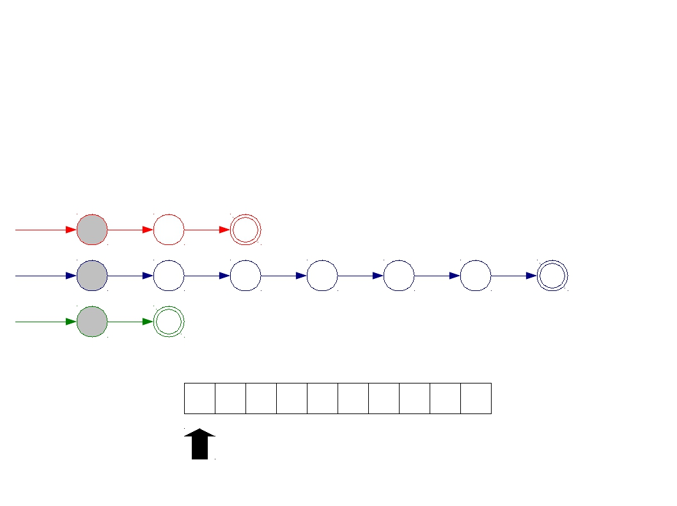
Implementing Maximal Munch
T_Do
T_Double
T_Mystery
do
double
[A-Za-z]
start
d
o
start
d
o
u
b
l
e
start
Σ
D O U B D O U B L E

Slide 15
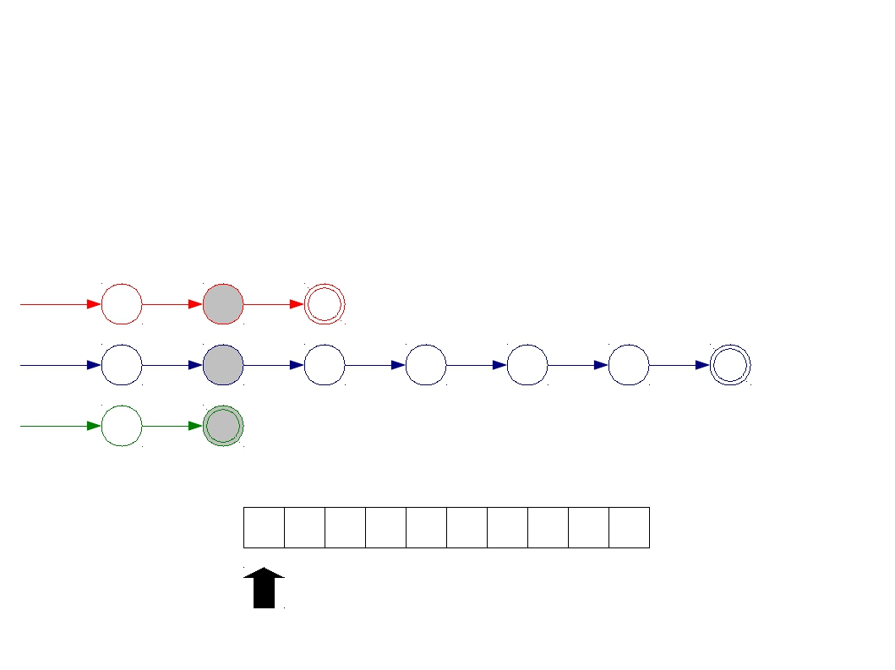
Implementing Maximal Munch
T_Do
T_Double
T_Mystery
do
double
[A-Za-z]
start
d
o
start
d
o
u
b
l
e
start
Σ
D O U B D O U B L E

Slide 16
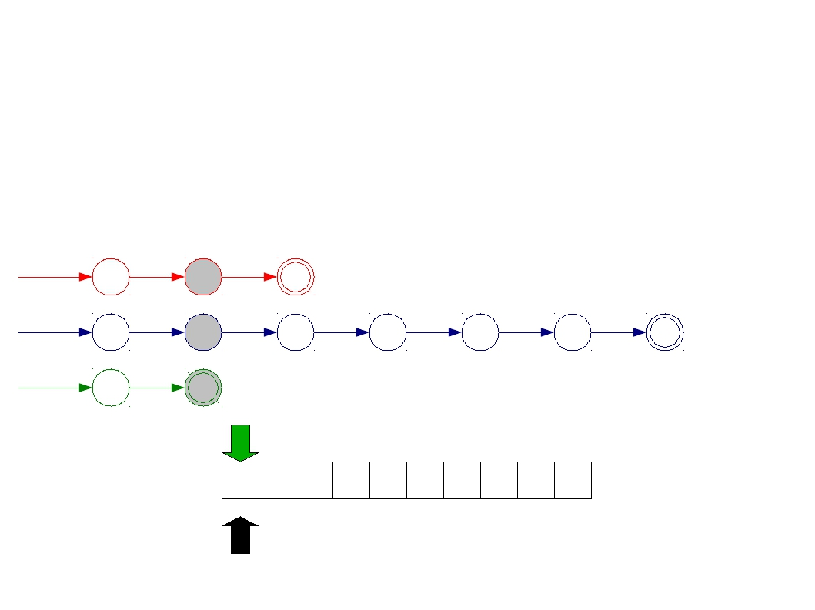
Implementing Maximal Munch
T_Do
T_Double
T_Mystery
do
double
[A-Za-z]
start
d
o
start
d
o
u
b
l
e
start
Σ
D O U B D O U B L E

Slide 17
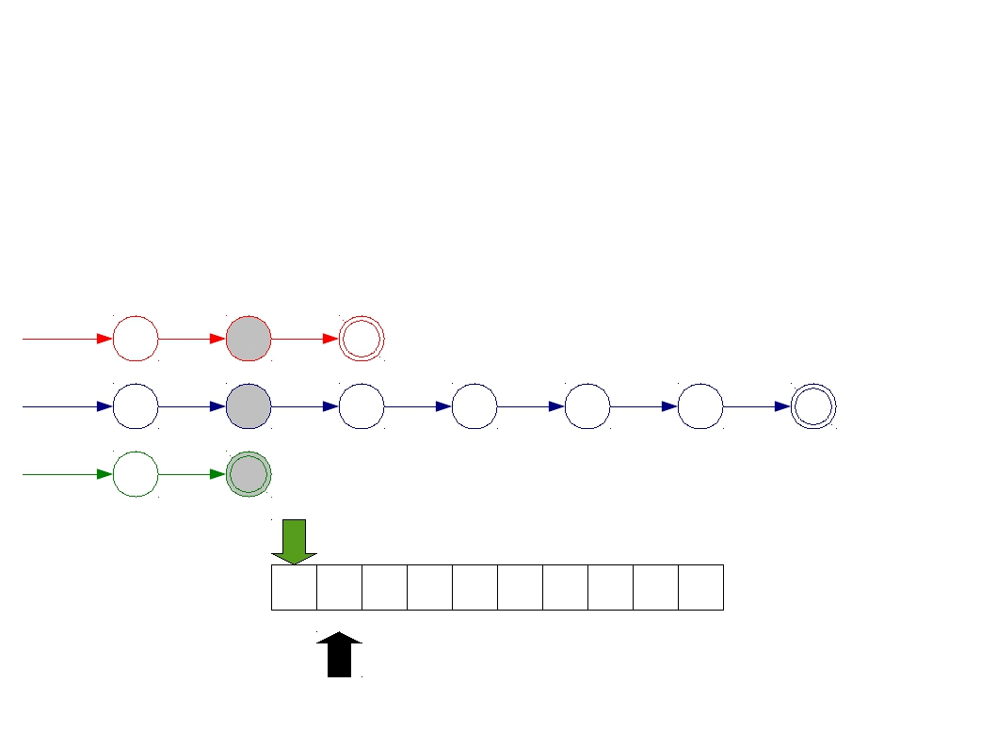
Implementing Maximal Munch
T_Do
T_Double
T_Mystery
do
double
[A-Za-z]
start
d
o
start
d
o
u
b
l
e
start
Σ
D O U B D O U B L E

Slide 18
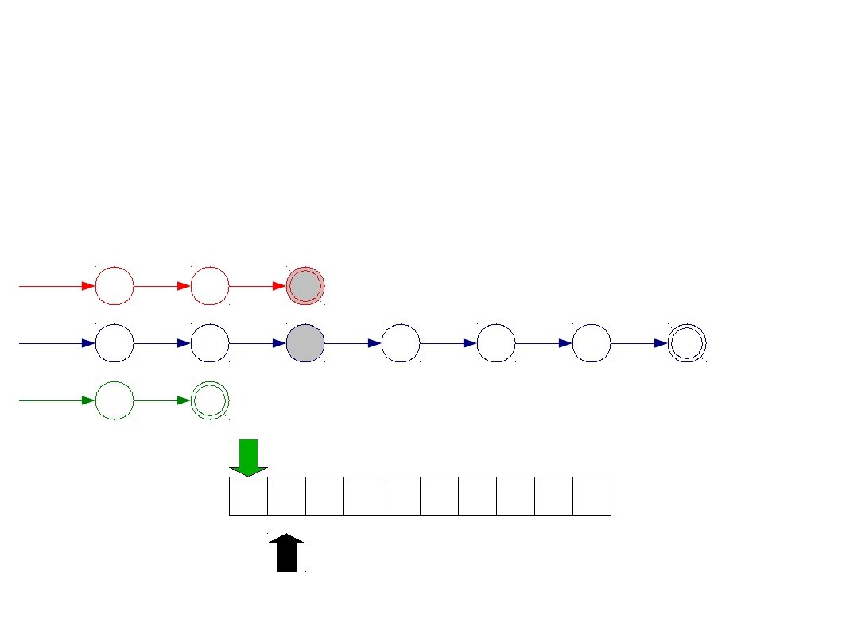
Implementing Maximal Munch
T_Do
T_Double
T_Mystery
do
double
[A-Za-z]
start
d
o
start
d
o
u
b
l
e
start
Σ
D O U B D O U B L E

Slide 19
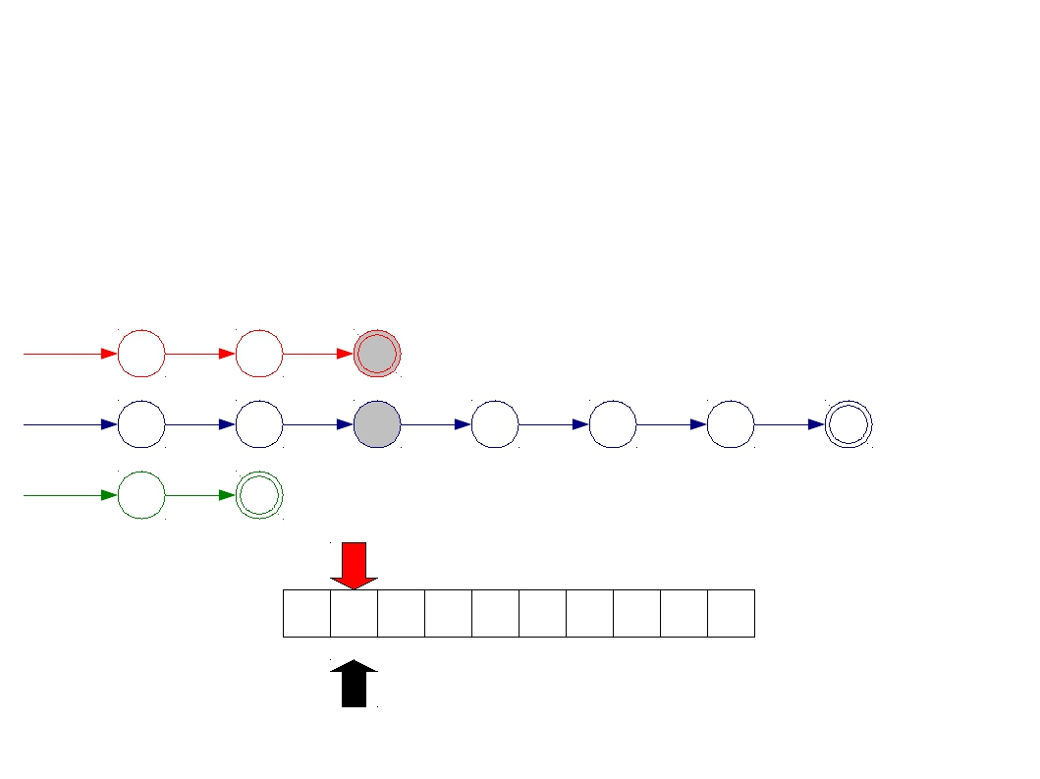
Implementing Maximal Munch
T_Do
T_Double
T_Mystery
do
double
[A-Za-z]
start
d
o
start
d
o
u
b
l
e
start
Σ
D O U B D O U B L E

Slide 20
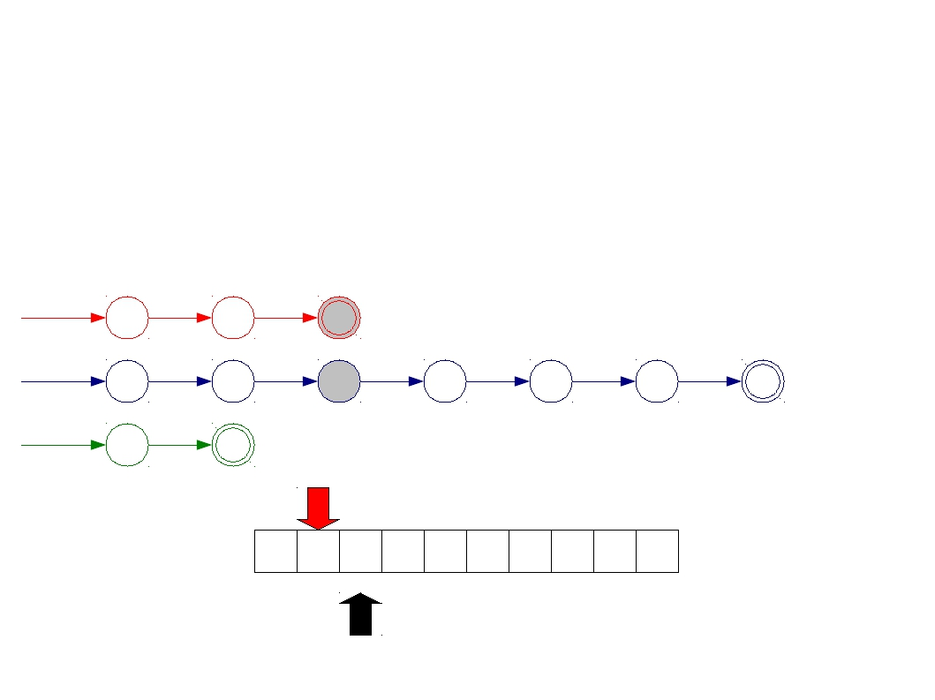
Implementing Maximal Munch
T_Do
T_Double
T_Mystery
do
double
[A-Za-z]
start
d
o
start
d
o
u
b
l
e
start
Σ
D O U B D O U B L E

Slide 21
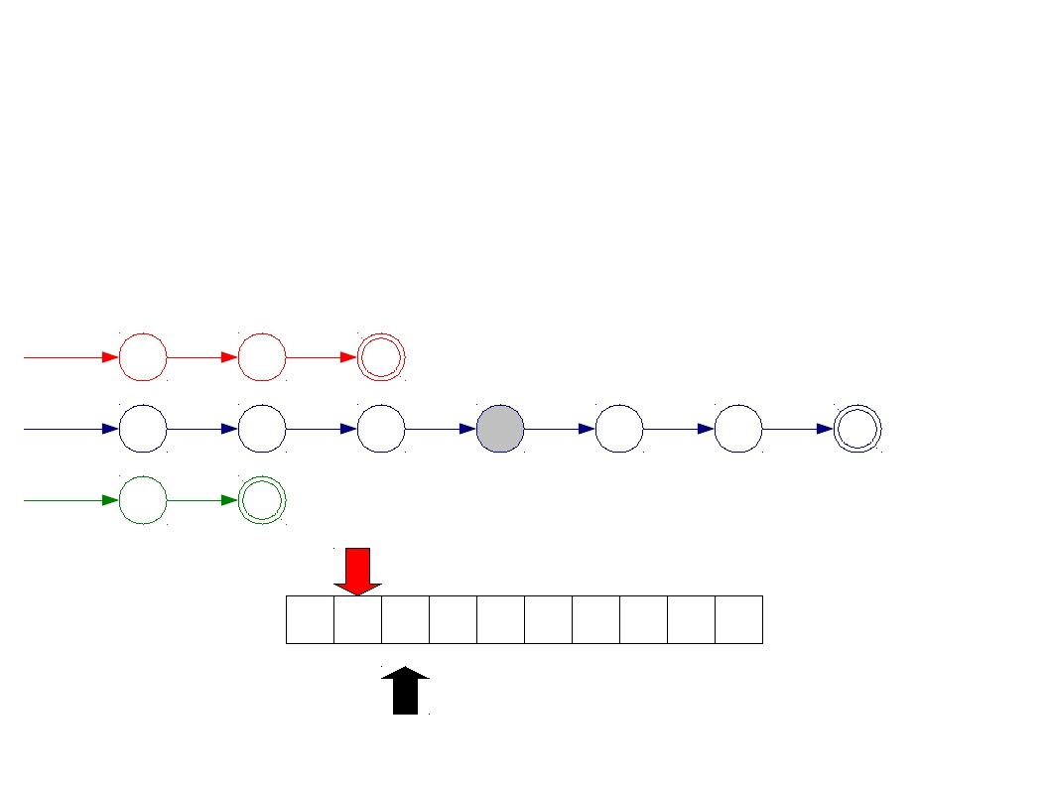
Implementing Maximal Munch
T_Do
T_Double
T_Mystery
do
double
[A-Za-z]
start
d
o
start
d
o
u
b
l
e
start
Σ
D O U B D O U B L E

Slide 22
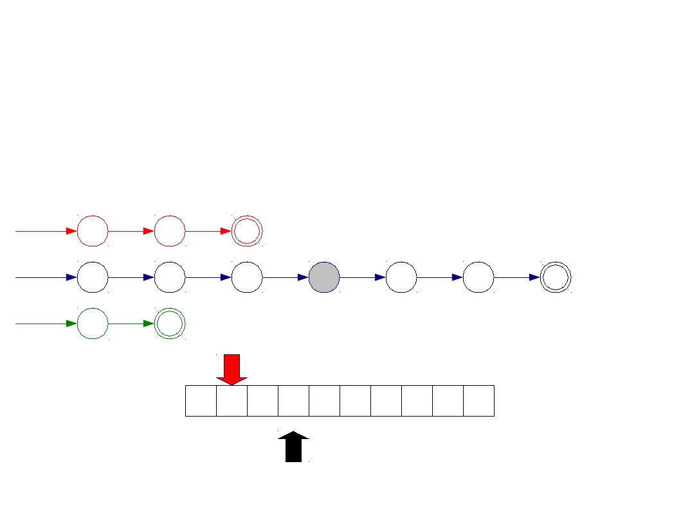
Implementing Maximal Munch
T_Do
T_Double
T_Mystery
do
double
[A-Za-z]
start
d
o
start
d
o
u
b
l
e
start
Σ
D O U B D O U B L E

Slide 23
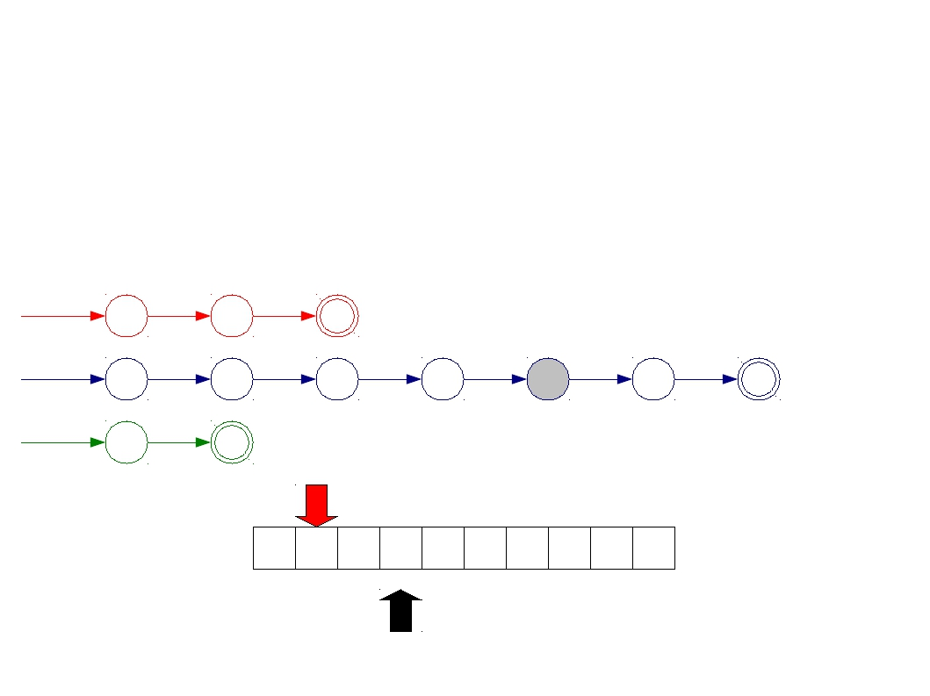
Implementing Maximal Munch
T_Do
T_Double
T_Mystery
do
double
[A-Za-z]
start
d
o
start
d
o
u
b
l
e
start
Σ
D O U B D O U B L E

Slide 24
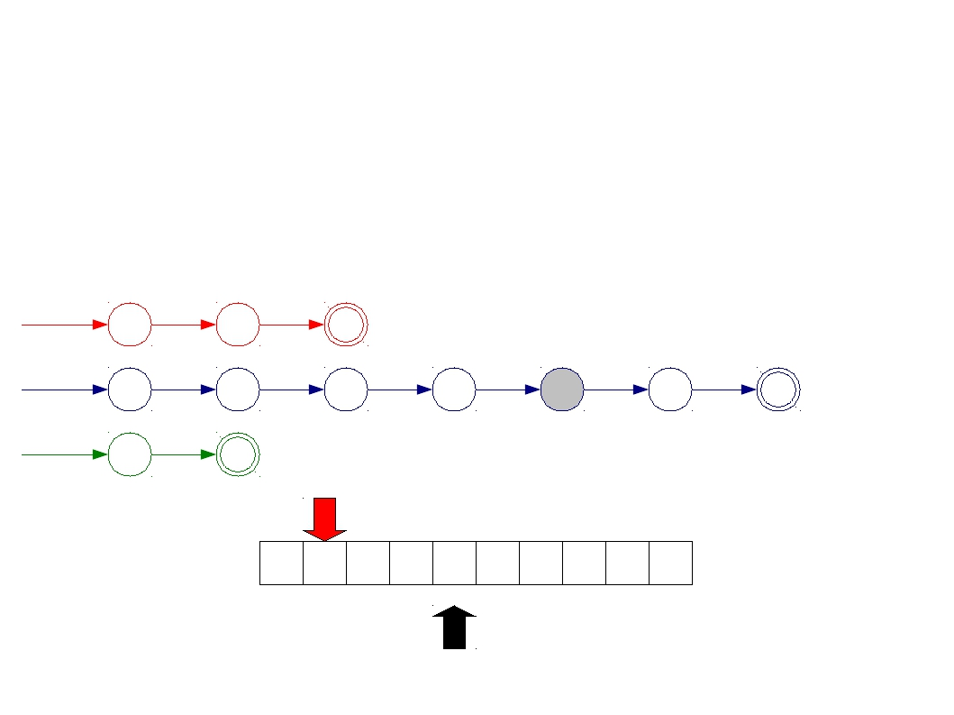
Implementing Maximal Munch
T_Do
T_Double
T_Mystery
do
double
[A-Za-z]
start
d
o
start
d
o
u
b
l
e
start
Σ
D O U B D O U B L E

Slide 25
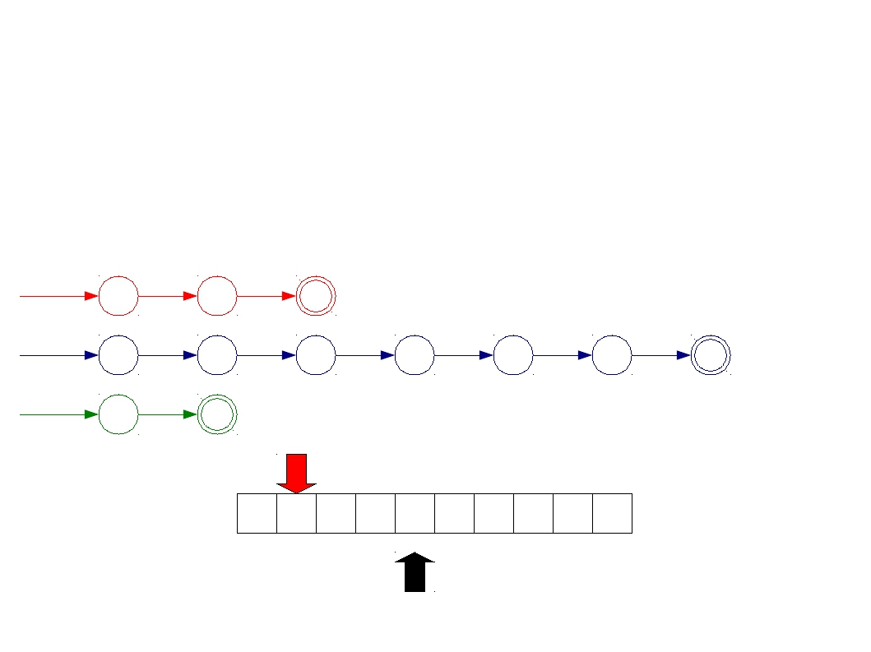
Implementing Maximal Munch
T_Do
T_Double
T_Mystery
do
double
[A-Za-z]
start
d
o
start
d
o
u
b
l
e
start
Σ
D O U B D O U B L E

Slide 26
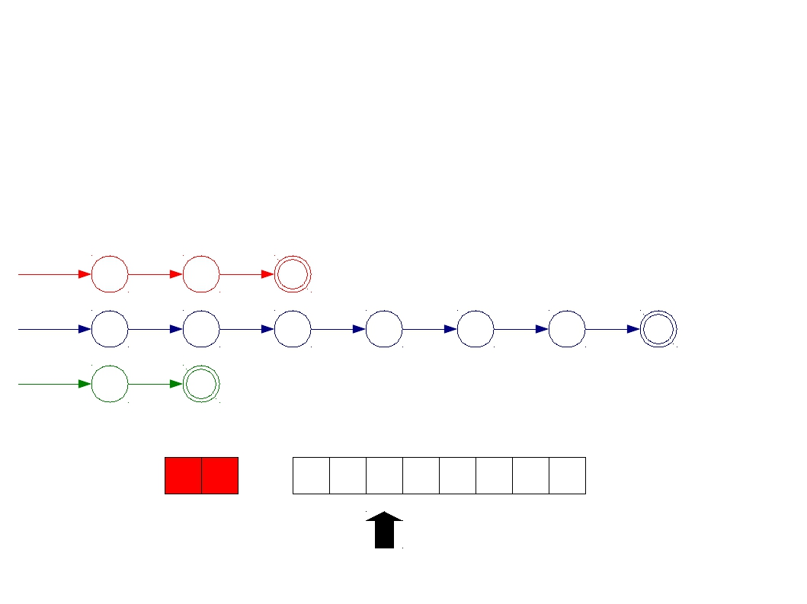
Implementing Maximal Munch
T_Do
T_Double
T_Mystery
do
double
[A-Za-z]
start
d
o
start
d
o
u
b
l
e
start
Σ
D O
U B D O U B L E

Slide 27
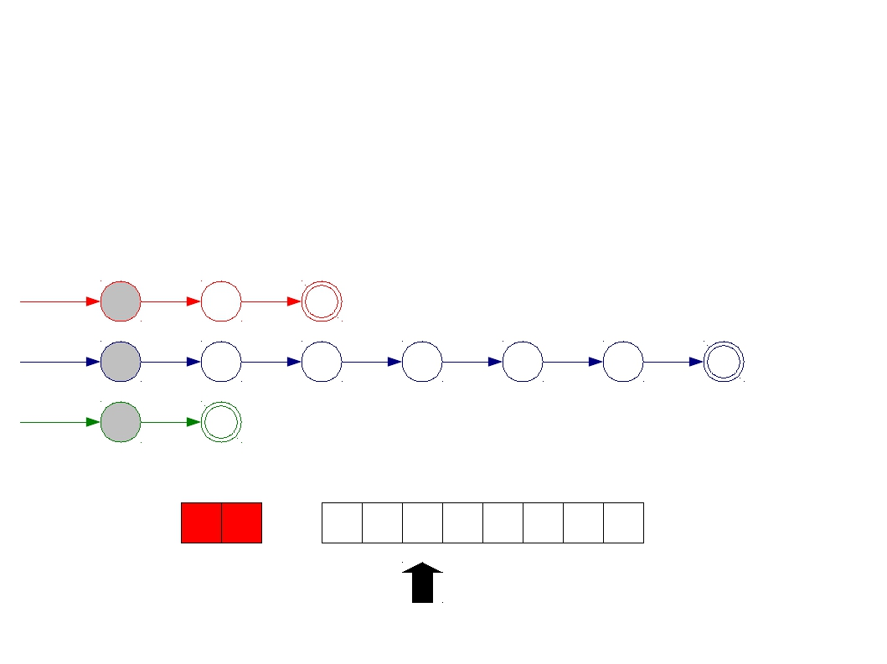
Implementing Maximal Munch
T_Do
T_Double
T_Mystery
do
double
[A-Za-z]
start
d
o
start
d
o
u
b
l
e
start
Σ
D O
U B D O U B L E

Slide 28
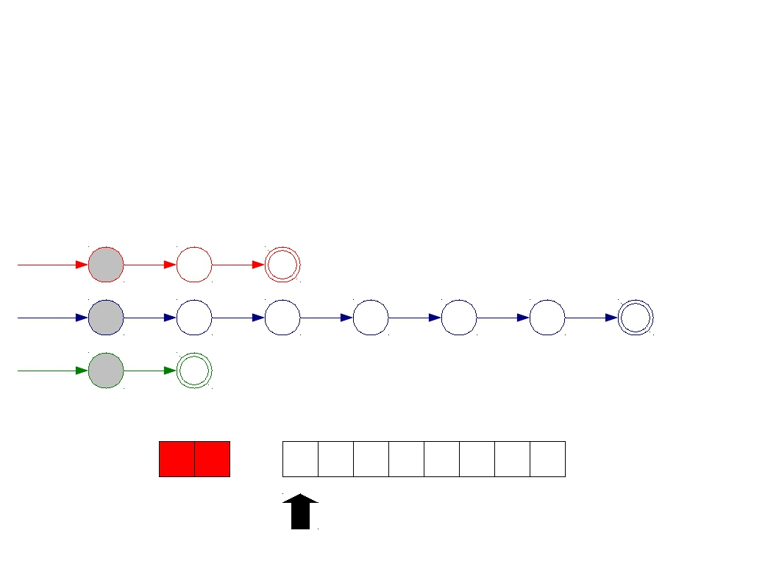
Implementing Maximal Munch
T_Do
T_Double
T_Mystery
do
double
[A-Za-z]
start
d
o
start
d
o
u
b
l
e
start
Σ
D O
U B D O U B L E

Slide 29
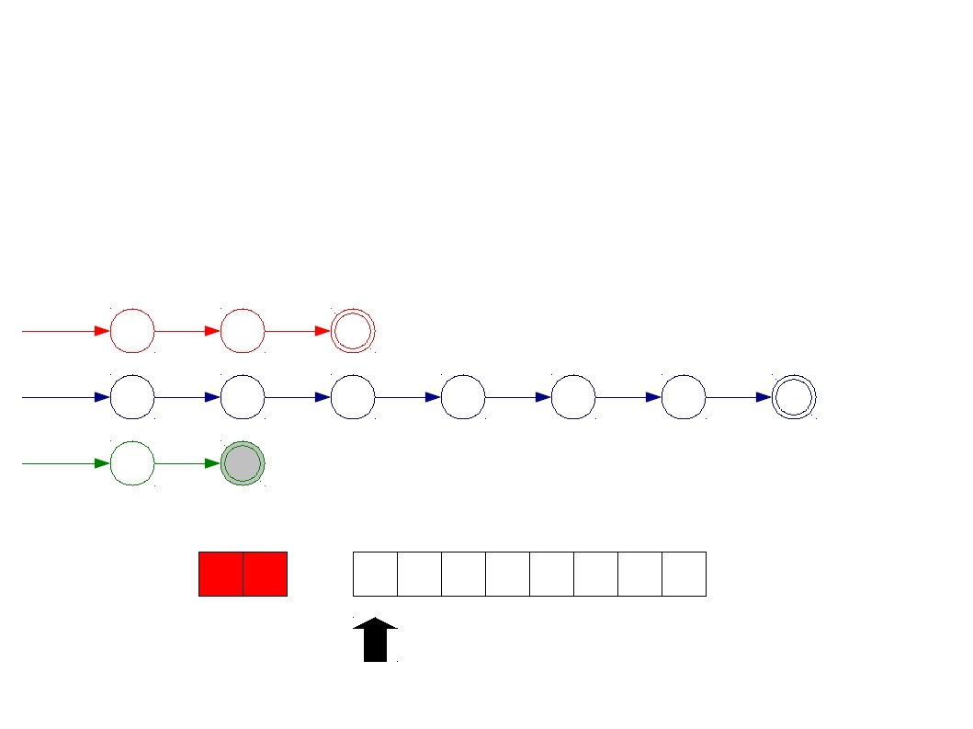
Implementing Maximal Munch
T_Do
T_Double
T_Mystery
do
double
[A-Za-z]
start
d
o
start
d
o
u
b
l
e
start
Σ
D O
U B D O U B L E

Slide 30
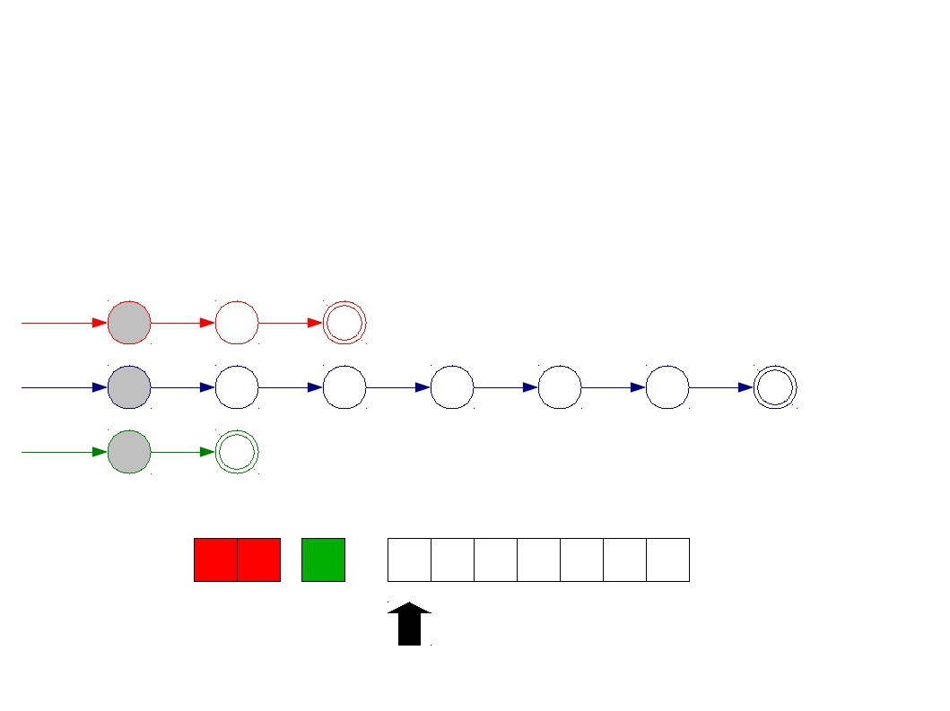
Implementing Maximal Munch
T_Do
T_Double
T_Mystery
do
double
[A-Za-z]
start
d
o
start
d
o
u
b
l
e
start
Σ
D O
U
B D O U B L E

Slide 31
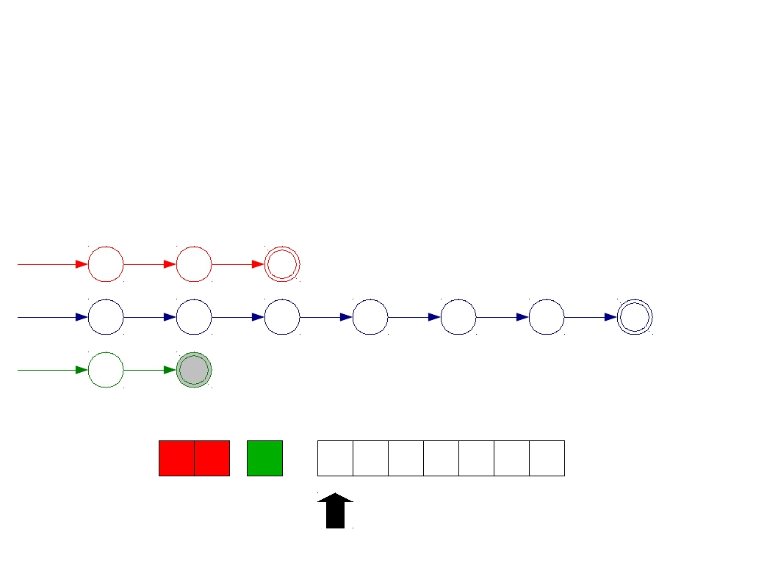
Implementing Maximal Munch
T_Do
T_Double
T_Mystery
do
double
[A-Za-z]
start
d
o
start
d
o
u
b
l
e
start
Σ
D O
U
B D O U B L E

Slide 32
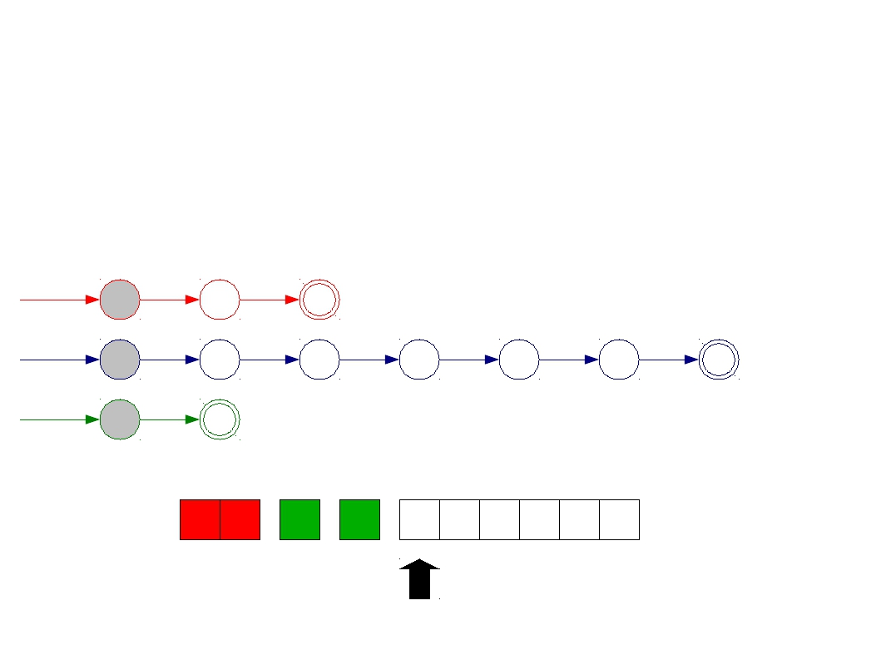
Implementing Maximal Munch
T_Do
T_Double
T_Mystery
do
double
[A-Za-z]
start
d
o
start
d
o
u
b
l
e
start
Σ
D O
U
B
D O U B L E

Slide 33
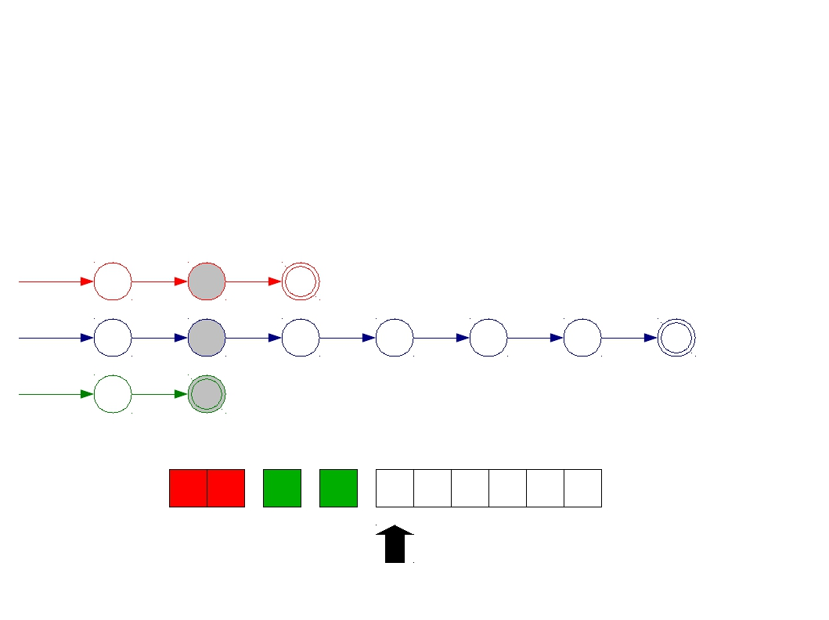
Implementing Maximal Munch
T_Do
T_Double
T_Mystery
do
double
[A-Za-z]
start
d
o
start
d
o
u
b
l
e
start
Σ
D O
U
B
D O U B L E

Slide 34
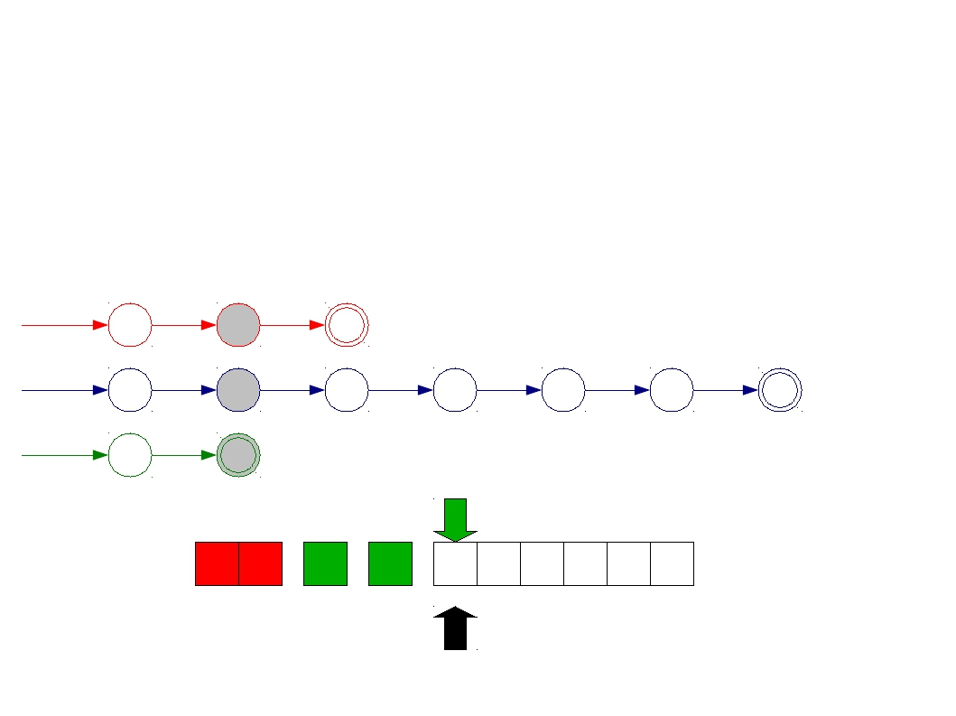
Implementing Maximal Munch
T_Do
T_Double
T_Mystery
do
double
[A-Za-z]
start
d
o
start
d
o
u
b
l
e
start
Σ
D O
U
B
D O U B L E

Slide 35
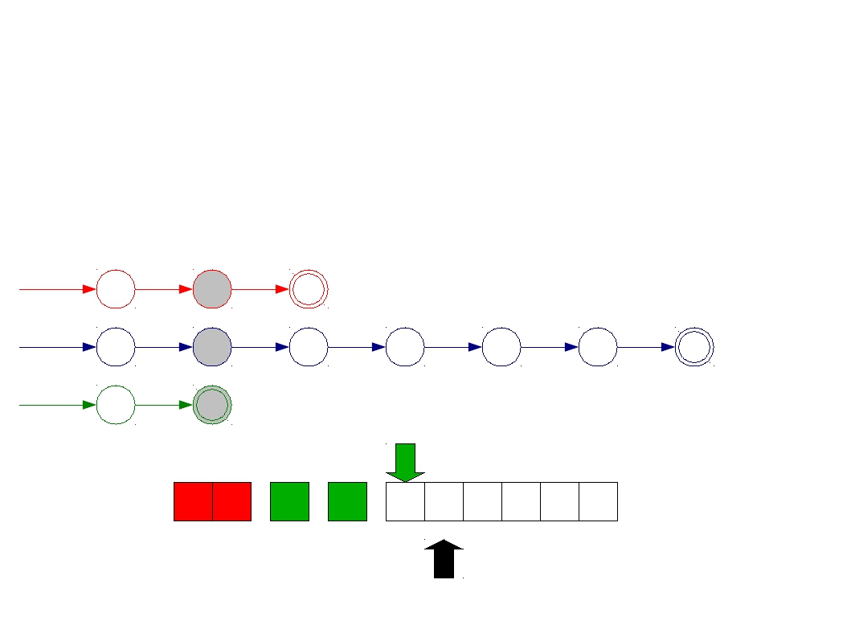
Implementing Maximal Munch
T_Do
T_Double
T_Mystery
do
double
[A-Za-z]
start
d
o
start
d
o
u
b
l
e
start
Σ
D O
U
B
D O U B L E

Slide 36
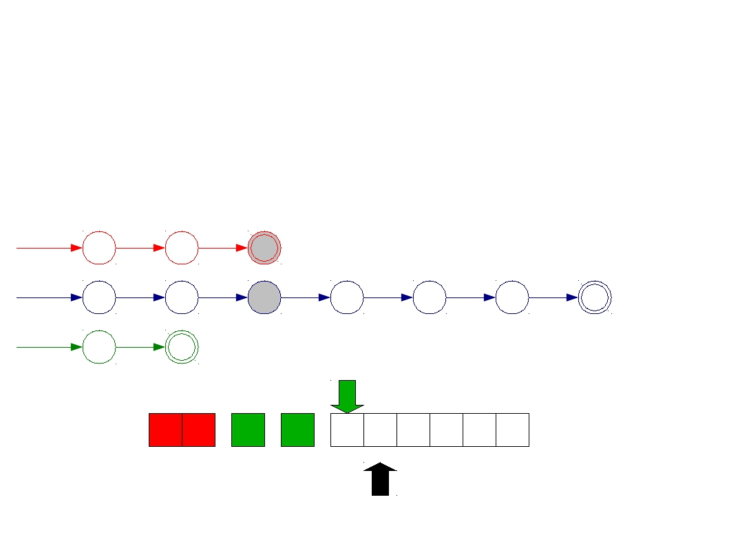
Implementing Maximal Munch
T_Do
T_Double
T_Mystery
do
double
[A-Za-z]
start
d
o
start
d
o
u
b
l
e
start
Σ
D O
U
B
D O U B L E

Slide 37
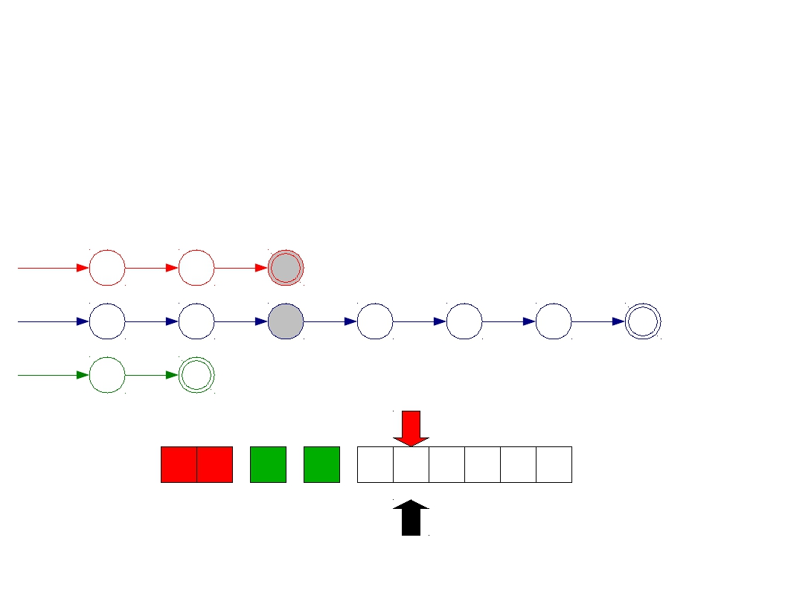
Implementing Maximal Munch
T_Do
T_Double
T_Mystery
do
double
[A-Za-z]
start
d
o
start
d
o
u
b
l
e
start
Σ
D O
U
B
D O U B L E

Slide 38
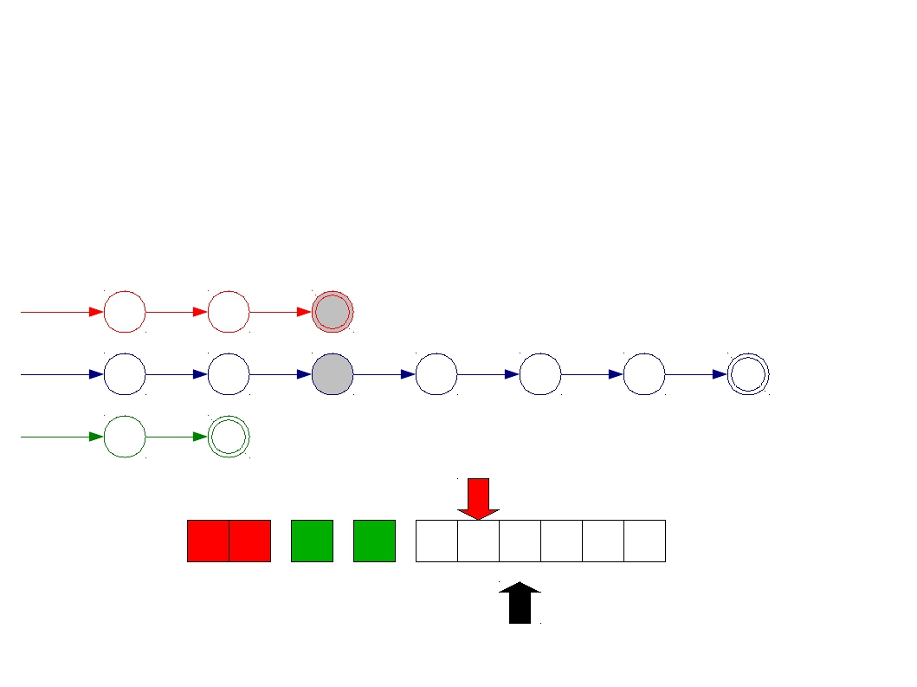
Implementing Maximal Munch
T_Do
T_Double
T_Mystery
do
double
[A-Za-z]
start
d
o
start
d
o
u
b
l
e
start
Σ
D O
U
B
D O U B L E

Slide 39
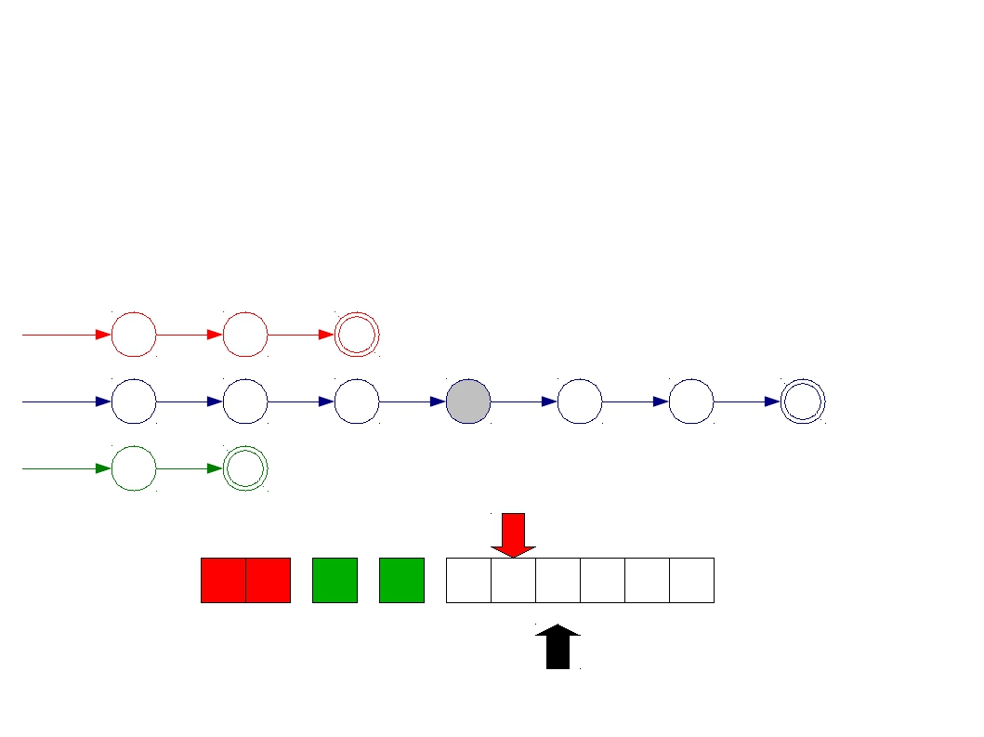
Implementing Maximal Munch
T_Do
T_Double
T_Mystery
do
double
[A-Za-z]
start
d
o
start
d
o
u
b
l
e
start
Σ
D O
U
B
D O U B L E

Slide 40
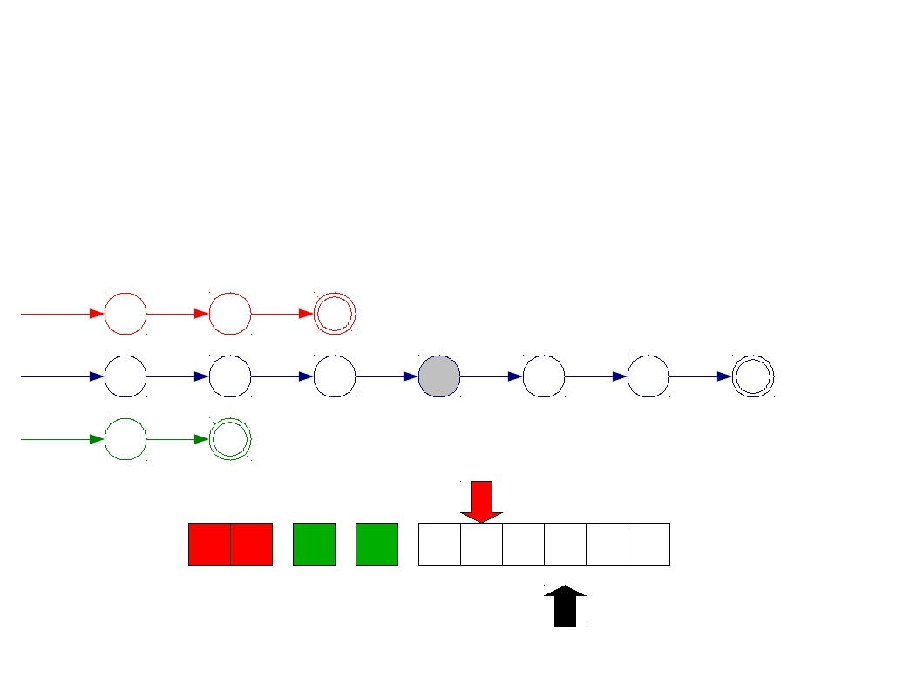
Implementing Maximal Munch
T_Do
T_Double
T_Mystery
do
double
[A-Za-z]
start
d
o
start
d
o
u
b
l
e
start
Σ
D O
U
B
D O U B L E

Slide 41
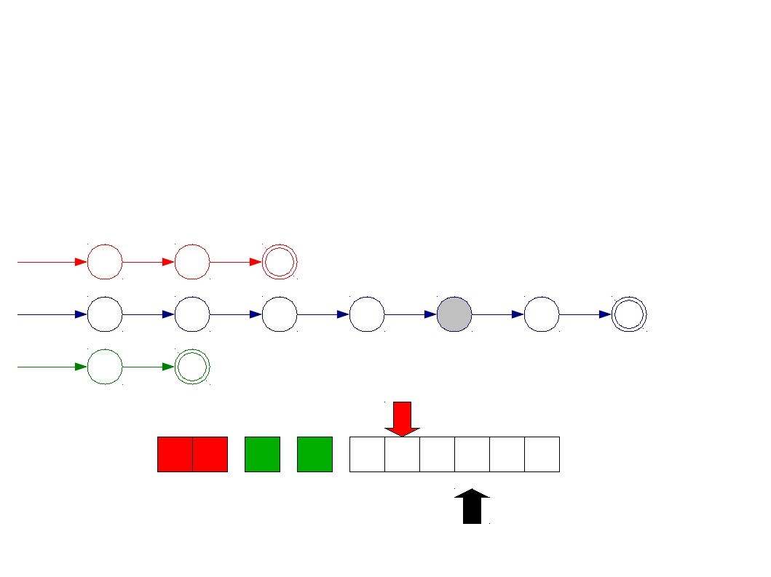
Implementing Maximal Munch
T_Do
T_Double
T_Mystery
do
double
[A-Za-z]
start
d
o
start
d
o
u
b
l
e
start
Σ
D O
U
B
D O U B L E

Slide 42
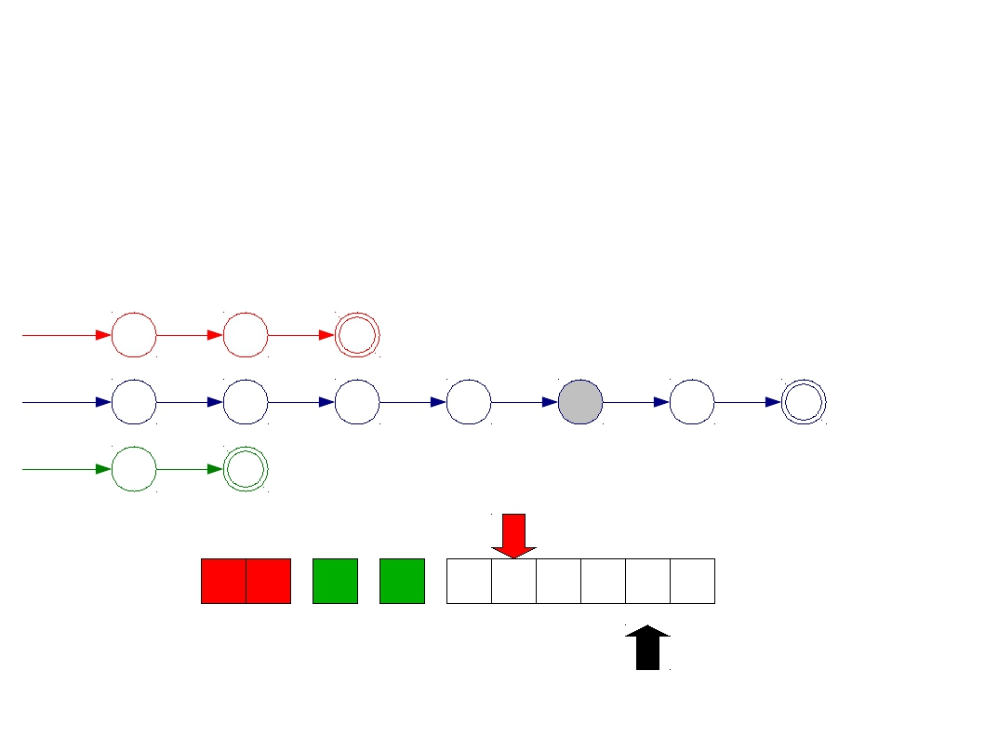
Implementing Maximal Munch
T_Do
T_Double
T_Mystery
do
double
[A-Za-z]
start
d
o
start
d
o
u
b
l
e
start
Σ
D O
U
B
D O U B L E

Slide 43
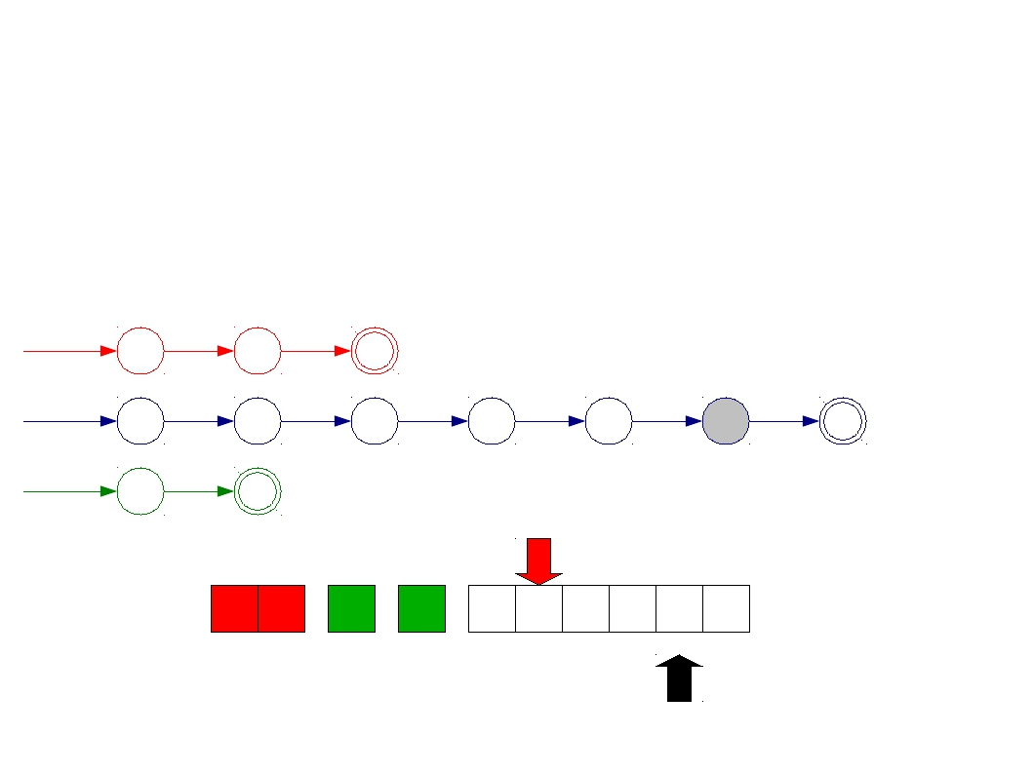
Implementing Maximal Munch
T_Do
T_Double
T_Mystery
do
double
[A-Za-z]
start
d
o
start
d
o
u
b
l
e
start
Σ
D O
U
B
D O U B L E

Slide 44
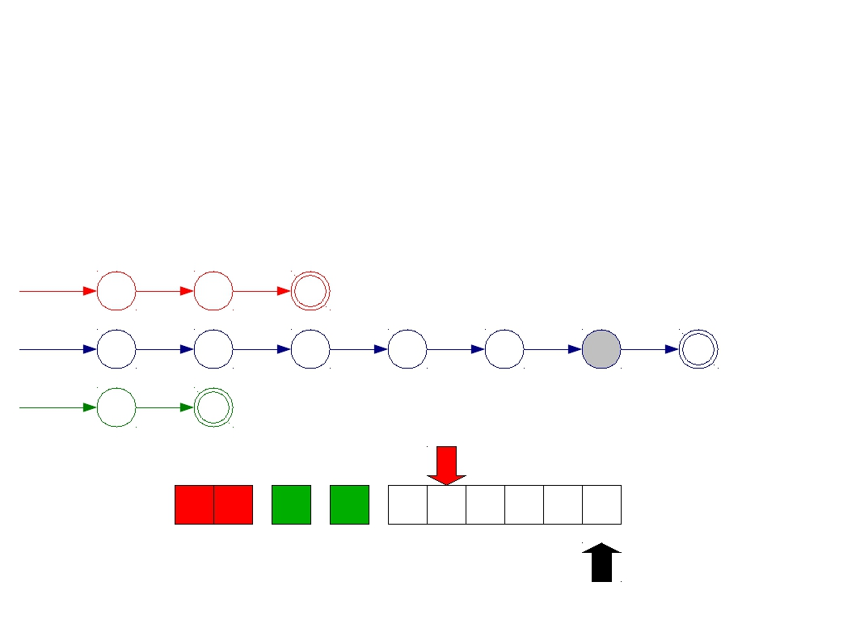
Implementing Maximal Munch
T_Do
T_Double
T_Mystery
do
double
[A-Za-z]
start
d
o
start
d
o
u
b
l
e
start
Σ
D O
U
B
D O U B L E

Slide 45
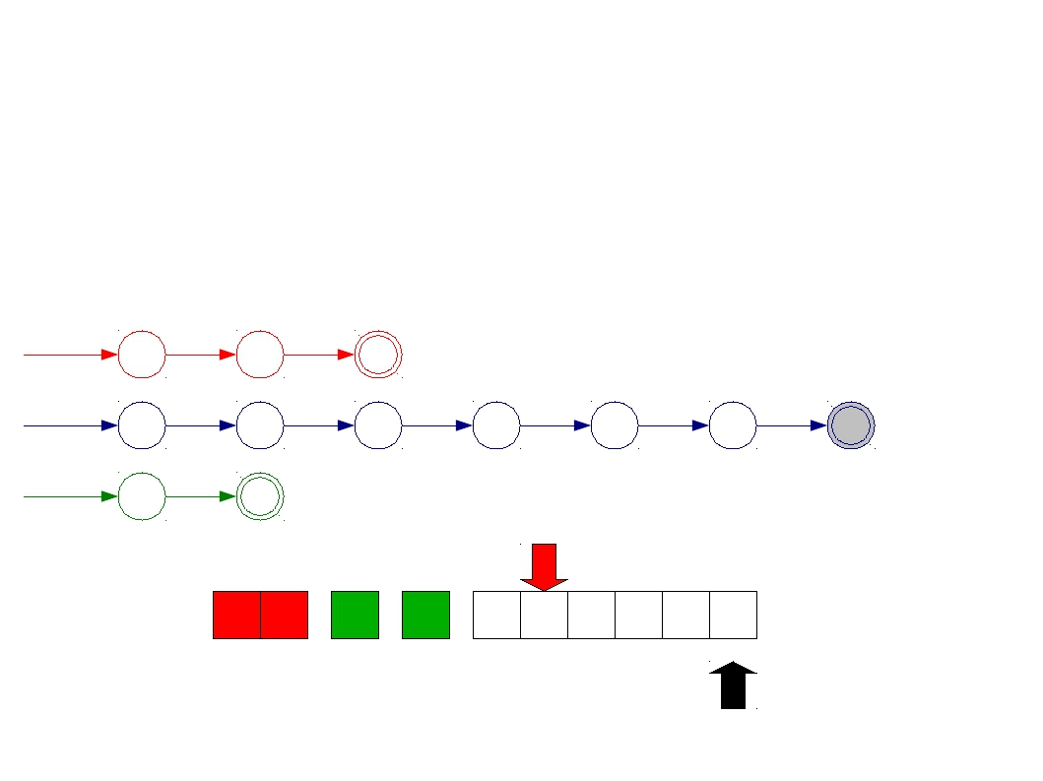
Implementing Maximal Munch
T_Do
T_Double
T_Mystery
do
double
[A-Za-z]
start
d
o
start
d
o
u
b
l
e
start
Σ
D O
U
B
D O U B L E

Slide 46
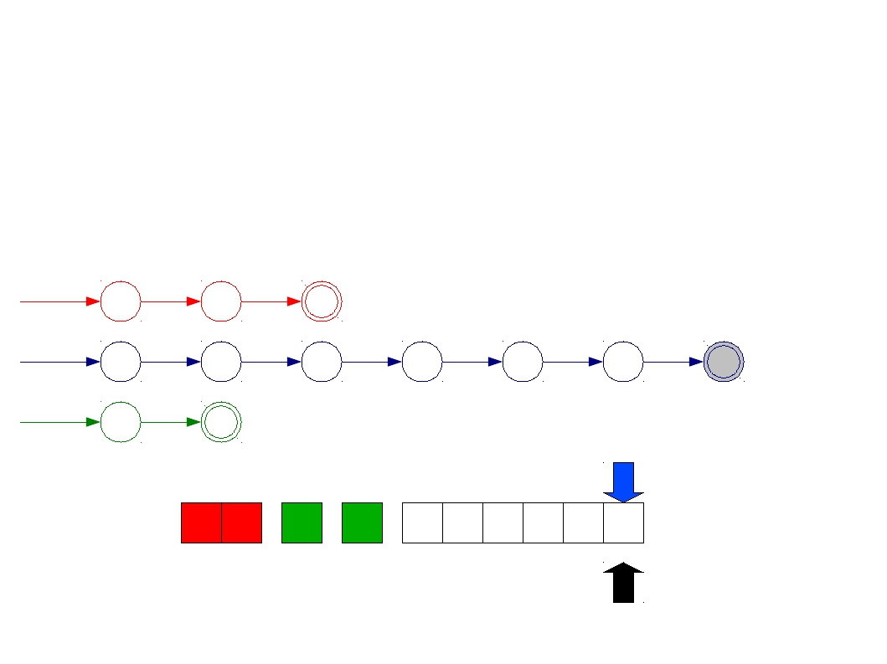
Implementing Maximal Munch
T_Do
T_Double
T_Mystery
do
double
[A-Za-z]
start
d
o
start
d
o
u
b
l
e
start
Σ
D O
U
B
D O U B L E

Slide 47
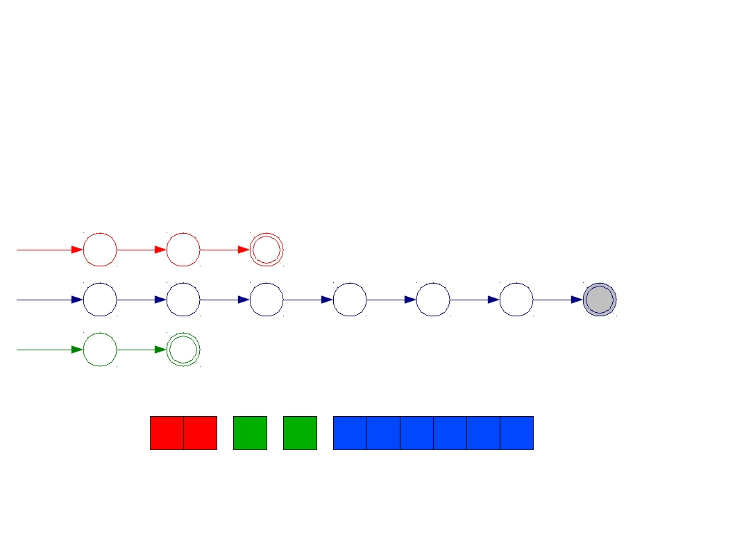
Implementing Maximal Munch
T_Do
T_Double
T_Mystery
do
double
[A-Za-z]
start
d
o
start
d
o
u
b
l
e
start
Σ
D O
U
B
D O U B L E

Slide 48
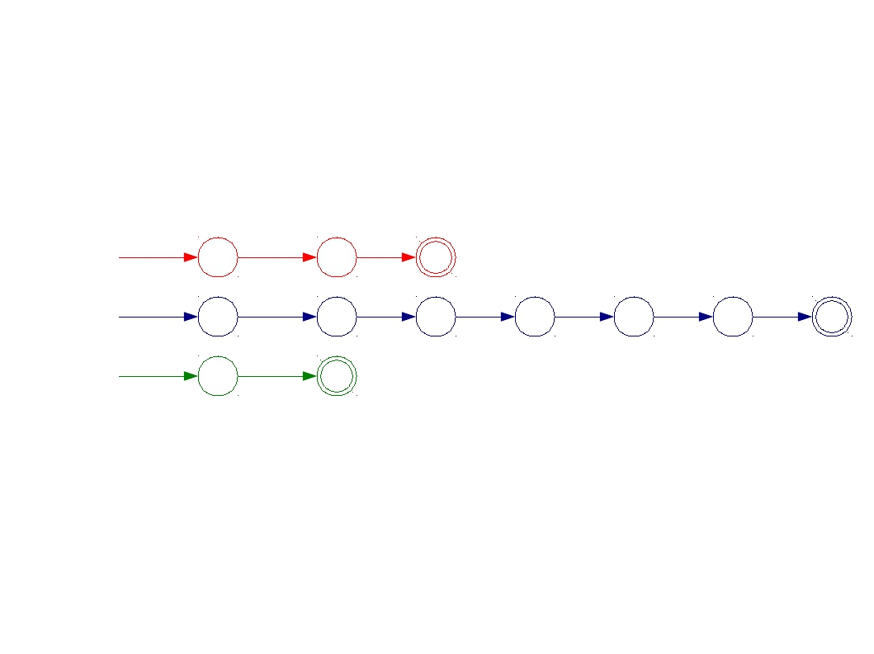
A Minor Simplification
start
d
o
start
d
o
u
b
l
e
start
Σ

Slide 49
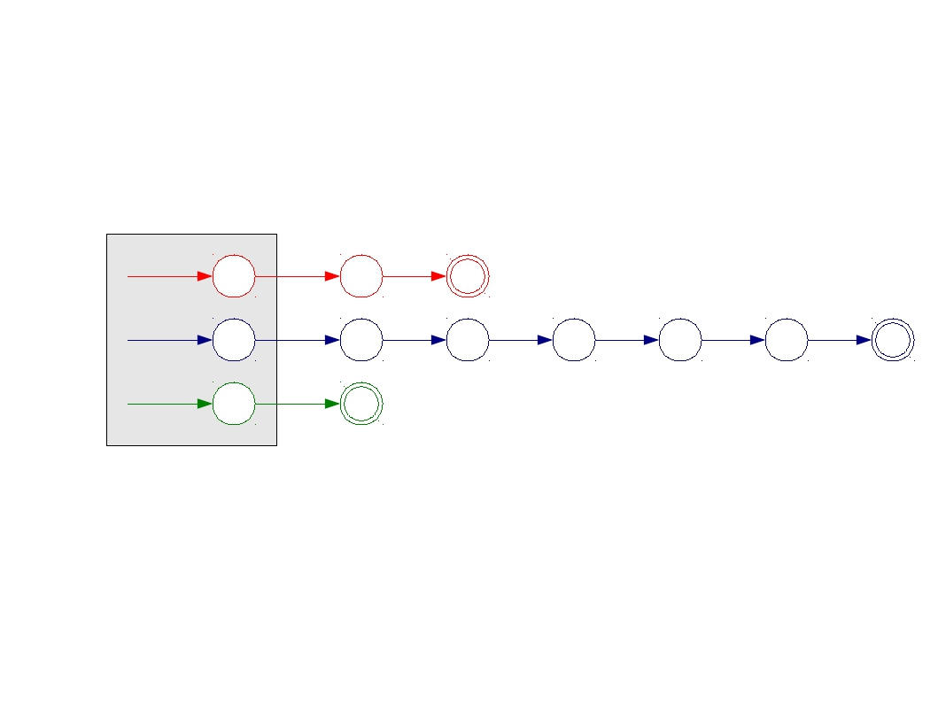
A Minor Simplification
start
d
o
start
d
o
u
b
l
e
start
Σ

Slide 50
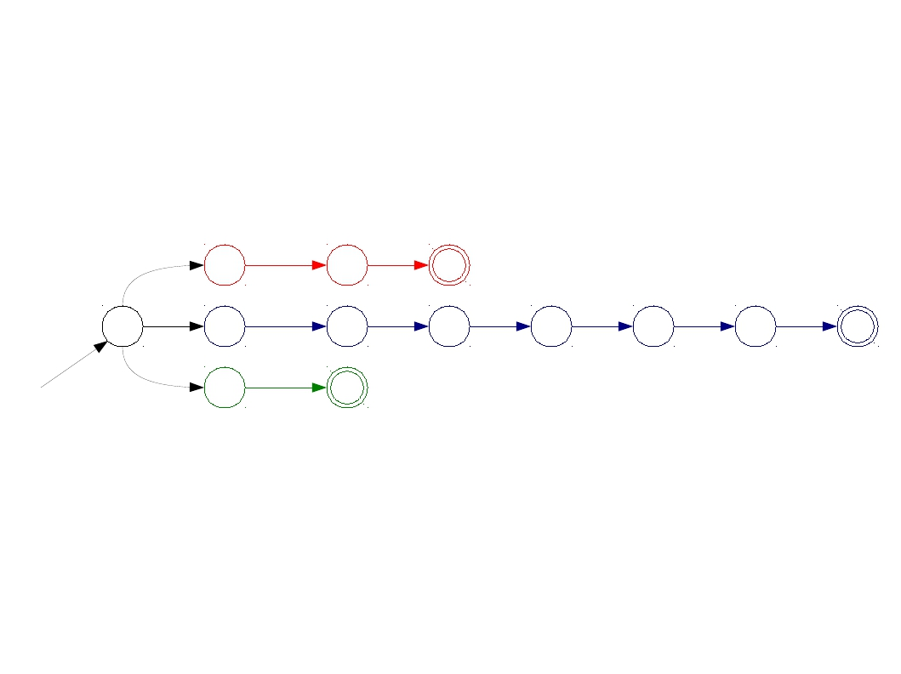
A Minor Simplification
ε
d
o
ε
d
o
u
b
l
e
start
ε
Σ

Slide 51
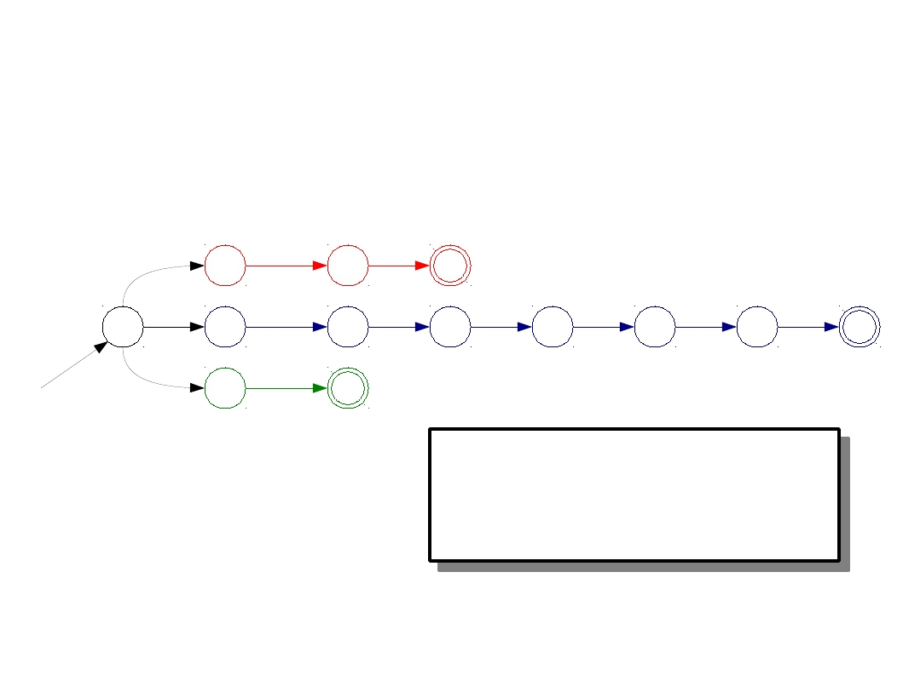
A Minor Simplification
ε
d
o
ε
d
o
u
b
l
e
start
ε
Σ
Build a single automaton that runs all the matching automata in parallel.

Slide 52
Challenges in Scanning
How do we determine which lexemes are associated with each token?
When there are multiple ways we could scan the input, how do we know which one to pick?
How do we address these concerns efficiently?

Slide 53
Other Conflicts
T_Do
T_Double
do
double
T_Identifier [A-Za-z_][A-Za-z0-9_]*

Slide 54
Other Conflicts
T_Do
T_Double
do
double
T_Identifier [A-Za-z_][A-Za-z0-9_]*
d o u b l e

Slide 55
Other Conflicts
T_Do
T_Double
do
double
T_Identifier [A-Za-z_][A-Za-z0-9_]*
d o u b l e
d | o | u | b | l | e
d | o | u | b | l | e

Slide 56
More Tiebreaking
When two regular expressions apply, choose the one with the greater “priority.”
Simple priority system: pick the rule that was defined first.

Slide 57
Other Conflicts
T_Do
T_Double
do
double
T_Identifier [A-Za-z_][A-Za-z0-9_]*
d o u b l e
d | o | u | b | l | e
d | o | u | b | l | e

Slide 58
Other Conflicts
T_Do
T_Double
do
double
T_Identifier [A-Za-z_][A-Za-z0-9_]*
d o u b l e
d o u b l e

Slide 59
Other Conflicts
T_Do
T_Double
do
double
T_Identifier [A-Za-z_][A-Za-z0-9_]*
d o u b l e
Why isn't
this a
problem?
d o u b l e

Slide 60
One Last Detail...
We know what to do if multiple rules match.
What if nothing matches?
Trick: Add a “catch-all” rule that matches any character and reports an error.

Slide 61
Summary of Conflict Resolution
Construct an automaton for each regular expression.
Merge them into one automaton by adding a new start state.
Scan the input, keeping track of the last known match.
Break ties by choosing higher-precedence matches.
Have a catch-all rule to handle errors.

Slide 62
Outline
From Regular Expressions to Implementation
From Regular expressions to NFAs
Inductive method
From NFA to DFA
Subset construction algorithm
Minimizing DFA
State-Minimization Algorithm
Conflict resolutions

Slide 63
From Regular Expressions to Implementation
现在进入SPOC，观看SPOC中第三讲的下列慕课视频
3-5 从正则表达式到有穷自动机
3-6 从NFA到DFA的转换
3-7 识别单词的DFA
做SPOC中第三讲的测验

